Slide 1
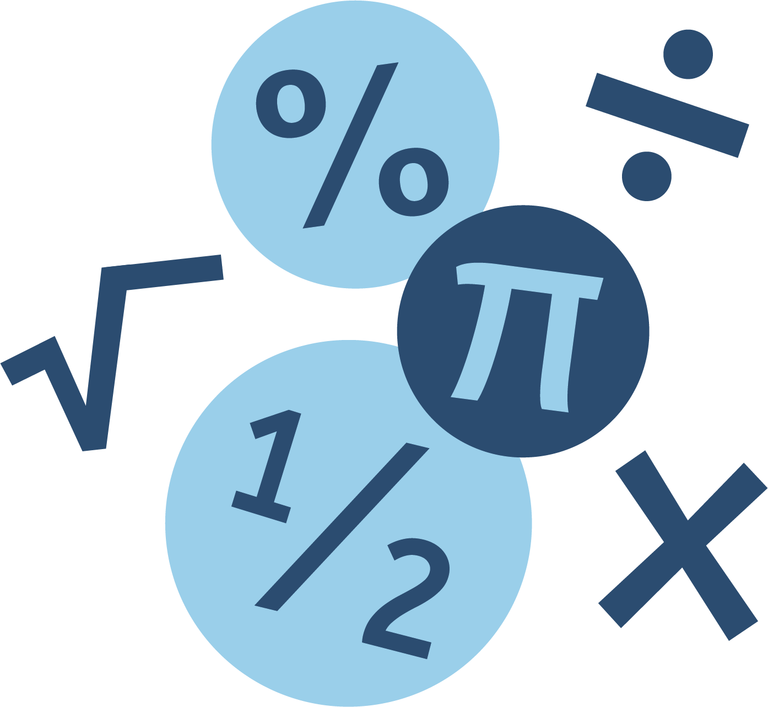
KS3 Overview
A
United Learning Schools, 2023-24
KS3 Mathematics
7.15
Polygons
8.12
Percentage Calculations
9.09
Expanding & Factorising
2
7.14
Fractions of amounts
7.16
Angles
8.11
FDP
8.13
Ratio 1
9.08
Standard Form
9.10
Forming Expressions & Substitution
Year 7
7.01
Numerical Skills
7.13
Comparing & ordering fractions
7.17
Coordinates
8.10
Direct Proportion
8.14
Area of Circles & Trapezia
9.07
Index Laws
9.11
Direct & Inverse Proportion
Key Stage
4
7.02
Order of Operations
7.12
Adding & subtracting fractions
7.18
Time
8.09
Circumference
8.15
Statistics 1
9.06
Algebraic Manipulation
9.12
Probability
1
9.22
Surface Area
7.03
Introduction to Algebra
7.11
Fraction Manipulation
Year 8
8.08
Angles in Parallel Lines
8.16
Averages & Spread
9.05
Fraction Calculations
9.13
Solving Equations 2
9.21
Arcs & Sectors
7.04
Primes,
Factors & Multiples
7.10 Area of Triangles & Quadrilaterals
8.01
Powers & Roots
8.07
Units of Measure
8.17
3D Visualisation
9.04
HCF & LCM of large numbers
9.14
Inequalities
1
9.20
Plans & Elevations
7.05
Expanding & Factorising 1
7.09
Multiplication & Division
8.02
Prime Factorisation
8.06
Coordinates & Basic Graphs
8.18
Volume 1
9.03
Related Calculations
9.15
Sequences
9.19
Transformations
1
7.06
Addition & Subtraction
7.08
Mean
8.03
Rounding
8.05
Solving Equations
1
Year 9
9.02
Estimation
& Limits of Accuracy
9.16
Pythagoras
9.18
Vectors
1
7.07
Perimeter
8.04
Fractions
9.01
Decimal Manipulation
9.17
Interior & Exterior Angles
United Curriculum

Slide 2
KS4 Overview
United Learning Schools 2023-24
KS4 Overview
United Learning Schools 2023-24
KS4 Mathematics
F10
Statistics 2
F10
Statistics 2
F9
Probability
2
F9
Probability
2
F11
Ratio 2
F11
Ratio 2
F8
Further graphs
F8
Further graphs
F12
Growth & decay
Year 7
F12
Growth & decay
Year 7
Foundation
Foundation
F1
Solving equations
& rearranging formulae
F1
Solving equations
& rearranging formulae
F19
Constructions & loci
F7
Quadractics - algebraic
F19
Constructions & loci
F7
Quadractics - algebraic
F13
Pythagoras review
F13
Pythagoras review
F14
Bearings & scale drawings
F2
Linear graphs
F14
Bearings & scale drawings
F2
Linear graphs
F6
Quadractics
- graphical
F6
Quadractics
- graphical
F18
Congruence
F18
Congruence
F3
Linear simultaneous equations
F3
Linear simultaneous equations
F5
Compound measures
F5
Compound measures
F15
Algebra review
F15
Algebra review
F17
Similar shapes
F17
Similar shapes
F16
Right angled trigonometry
F4
Volume
2
F16
Right angled trigonometry
F4
Volume
2
United Curriculum

Slide 3
KS4 Overview
United Learning Schools (and external) 2024-25
KS4 Mathematics
H12
Growth & decay
H26
Inequalities
2
H11
Cumulative frequency & box plots
H13
Ratio
2
H25
Further trigonometry
H27
Functions
H10
Statistics
2
H14
Ratio
3
H24
Simultaneous equations
2
H28
Iteration
Higher
H1
Rearranging formulae
H9
Probability 2
H15
Similar shapes
H23
Quadratic sequences
H29
Algebraic proof
H2
Linear graphs
H8
Further graphs
H16
Algebraic proportion
H22
Recurring decimals
H30
Circle theorems
H36
Constructions & loci
H3
Linear simultaneous equations
H7
Quadratics - algebraic
H17
Surds
H21
Transformations
2
H31
Histograms
H35
Congruence
H4
Volume 2
H6
Quadratics
- graphical
H18
Right angled trigonometry
H20
Bearings & scale drawings
H32
Vectors
2
H34
Graphical transformations
H5
Compound measures
H33
Gradients (further), & area under a graph
H19
Bounds
United Curriculum

